Slide 1


RLPSA MEMBER DISCUSSION:
FIFA WORLD CUP 2026
Presented by: Ruben J Olivas – Director of Asset Protection, Whataburger

Slide 2
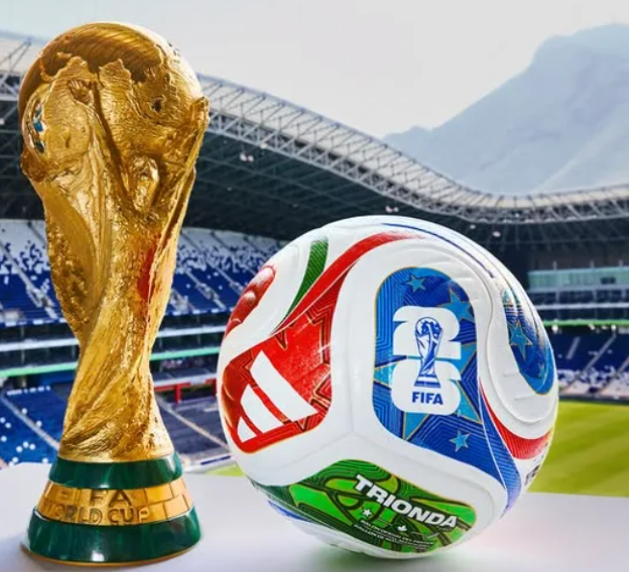
What does FIFA stand for?
International Federation of Association Football

Slide 3
FIFA STATS
2026 FIFA World Cup, hosted by Canada, Mexico, and the USA, features a 48-team format with 104 total matches over 39 days, starting in June 2026.
Economic Impact: The tournament is expected to contribute a combined $62 billion Economic Impact across all three host nations (USA, Canada Mexico).
Approximately 6.5 million people are expected to attend the 2026 FIFA World Cup matches in-stadium across the United States, Canada, and Mexico, making it the largest sporting event in history.
The U.S. State Department expects nearly 10 million total visitors to travel to the 11 U.S. host cities during the tournament.
Average ticket price, approximately $1,603 across 104 matches.
The opening match kicks off on June 11, 2026, at Estadio Azteca in Mexico City, while the World Cup Final will take place on July 19, 2026, at MetLife Stadium in New York/New Jersey.
The FIFA World Cup is the world's most-watched sporting event, far exceeding the global viewership of the NFL Super Bowl, NBA, and even the Summer Olympics in many regions.
There are friendly matches occurring within the USA, prior to opening match.

Slide 4
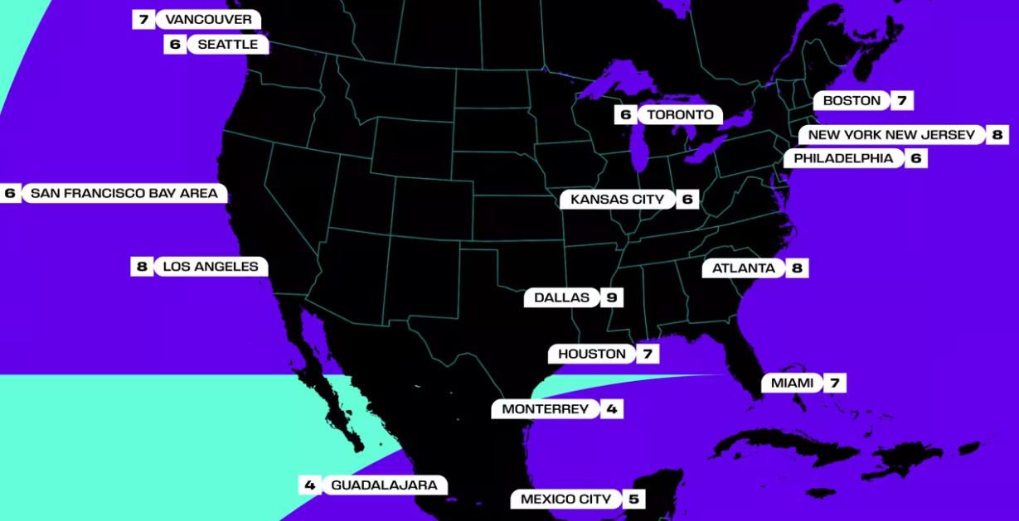
16 Cities Hosting Matches

Slide 5
Law Enforcement STATS
Law enforcement agencies are implementing an "unprecedented" security and intelligence operation for the 2026 FIFA World Cup, with a heavy emphasis on multi-agency coordination, advanced technology, and a "whole-of-nation" approach to ensure safety.
Federal Emergency Management Agency (FEMA) funds are supporting security measures, including nearly $625 million in grants to host cities to protect infrastructure and increase police presence around venues, hotels, and transportation hubs.
Counter-Drone Measures: Stadiums and surrounding airspace will be designated no-fly zones, with law enforcement utilizing Federal Bureau of Investigation (FBI) technology to track and neutralize unauthorized drones.
A 50-member task force is coordinating efforts to combat human trafficking, with police conducting public awareness campaigns in hotels, motels, and transport hubs.
In the United States alone, the LEO effort involves a massive collaborative approach, utilizing over 70 different federal, state, and local agencies for these major FIFA events.

Slide 6
2026 World Cup Concerns (North America)
Mexico Regional Violence: Concerns are rising regarding the Jalisco New Generation Cartel, particularly after recent killings in Guadalajara, a host city.
U.S. Gun Violence: The shooting during the 2024 Kansas City Super Bowl parade highlighted the risks of large public gatherings in the US.
Terrorism & Lone Actors: Authorities are monitoring potential threats from IS-linked groups and self-radicalized individuals, particularly with high-profile events.
Human Trafficking: Law enforcement in host cities like Atlanta are preparing for a potential spike in sex and labor trafficking.
Protests & Civil Unrest: The tournament coincides with potential anti-government or political protests in the U.S. and Canada.
FIFA has amended its disciplinary codes to allow officials to stop games in cases of racism, threats and violence.

Slide 7
Past Threats and Violence
1998 World Cup (France): A planned attack by the Algerian Armed Islamic Group, backed by Osama bin Laden, was thwarted by security operations across five countries, which included plans to bomb stadiums and hotels.
2015 Stade de France Attacks: The Islamic State (IS) targeted the France vs. Germany match with suicide bombings and shootings at the stadium perimeter.
2022 World Cup (Qatar): While matches were secure, tournament preparation was marked by significant human rights issues, including the death of migrant workers.
2022 Querétaro-Atlas Riot (Mexico): A Liga MX match saw brutal violence, leaving 26 people injured and raising fears of similar incidents in 2026.
2022/2023 Post-Match Riots: Following matches in the 2022 World Cup, fans clashed with police in multiple cities, including Brussels, Rotterdam, and Amsterdam.

Slide 8
HOW do we prepare as an AP/LP community?
Identity which locations of your operations will experience an increase of fans/visitors (What mile radius makes sense?)
Train/Refresh employees on utilization of your current security recourses, (CCTV, Panic Buttons, Calling police, deescalation, proper reporting of incidents)
Will you need contract security? Secure soon, demand is high during this tournament.
Partner with your operations folks on their plan for the increase sales volumes. (Keeping customers/fans, happy vs agitated due to long wait times)
Utilize FREE recourses available to identify watch parties, fan zones/festivals, team hotels, team practice base camps, and threats/violence. (Social media, news apps, LE, etc.. share information with your OPS teams)
It’s not to late to invest in a AI-Powered Real-Time Event, Threat & Risk Intelligence source.
Review/refresh response plan/protocol to violence/threats within your stores, restaurants and our AP/LP teams.
Are our teams ready to pivot, support and respond as needed?
WE are ALL security professionals, and knowledge is power, let’s share what is working and what is not!
"Prepare and prevent, don't repair and repent"

Slide 9

Reminder that registration is now open for the first CONNECT event of the year! On June 4, join us at Domino's Farms for a gathering of restaurant members to share insights, tackle challenges, and build relationships that drive real results.
FREE for all restaurant RLPSA members?

Slide 10
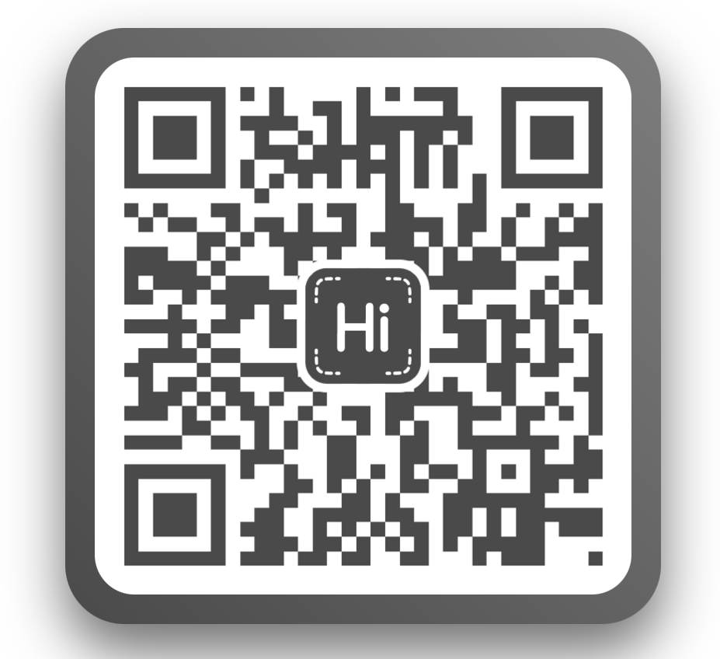
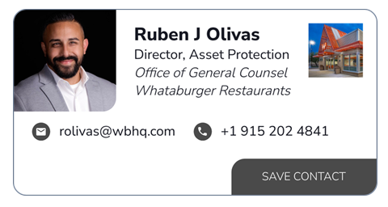
Let’s Stay Connected

Slide 11
THANK YOU FOR ATTENDING!
IF YOU'RE INTERESTED IN LEARNING MORE ABOUT RLPSA WORKING GROUPS OR REGIONAL CHAPTERS, REACH OUT TO US DIRECTLY.
INFO@RLPSA.ORG
WWW.RLPSA.COM
WE’D LOVE TO CONNECT WITH YOU.
Follow us on Linkedin and Facebook!

